Slide 1

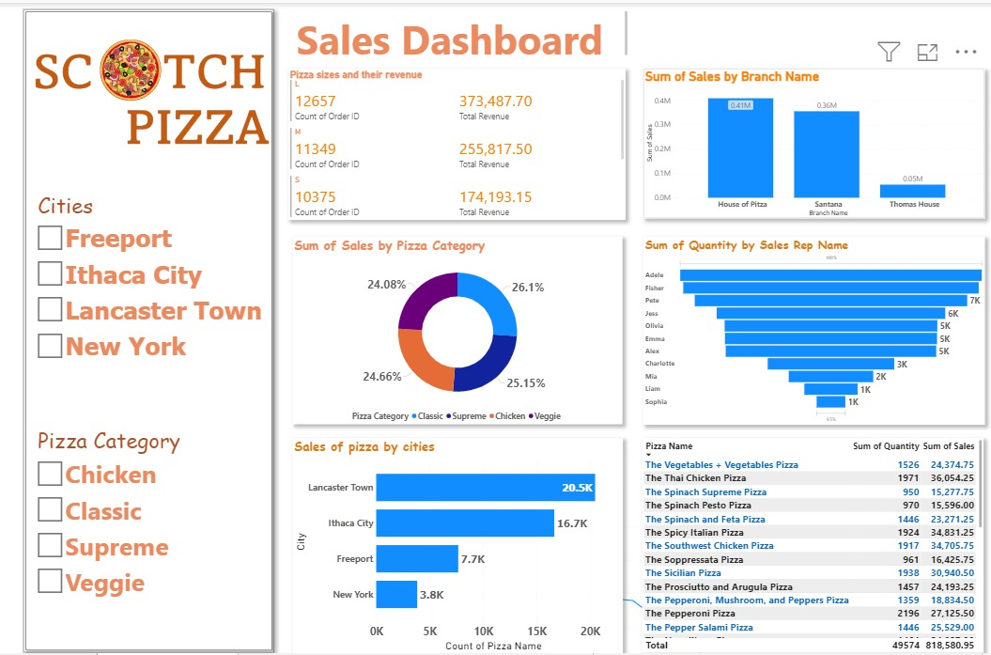
A PROJECT SUBMITTED
TO
HAGITAL CONSULTING LIMITED
ON
DATA ANALYSIS PROGRAMME USING POWER BI
TITLED:
PRESENTED BY TEAM FIVE (5) MEMBERS

Slide 2
TABLE OF CONTENTS
List of Team Members
Introduction/Background and Business Problem Identification
Data Collection & Pre-processing
Analysis and Results
Visualization
Limitations of the Data Set
Conclusion & Recommendation

Slide 3
TEAM FIVE (5) MEMBERS
NONSO STANLEY AGANOKE - TEAM LED
EFFIONG JACOB – ASST. TEAM LED
OBIAGELI MONEME
AKINLABI OTEBOLAKU
LUKMON YAKUB
PRINCE CHINONSO ONYEMAKA
REMI AJALA
OLUBAMISE
OLONADE HAKEEM BABAJIDE (LUMPUR)

Slide 4
Brief intro/Background and problem identification / Objective of the Analysis
INTRODUCTION
Scotch Pizzas chain, a renowned Pizza producing firm over the years have been matching up to the expected sumptuous taste of pizza lovers in the country. Different age groups have been patronizing the company but with different turnouts.
To some extent, the company have been generating data but yet to be analyzed
BUSINESS PROBLEM IDENTIFICATION / OBJECTIVE OF THE PROJECT:
The problem and primary objective of this project is to identify customer behavior and preferences, popular pizzas and branches, pricing, inventory decisions, and operating performance.
Other problem is Inability to make sense to the data collected from sales department for the management decision.

Slide 5
Data Collection & Pre-processing
DATA COLLECTION
A pizza restaurant chain, Scotch pizzas have collected data on pizza sales over the past year. However, the data provided for the analysis was only 2022 data.
The data includes information about order ID, pizza ID, quantity, date and time of order, pizza size, pizza price, pizza name, pizza category, branch name, city, and sales rep name.
DATA PRE-PROCESSING
We processed the data provided by Scotch Pizza by performing the following tasks:
Data cleaning and checking of duplicates, errors in excel and also in Power Query interface
Creation of additional column for Sales Values
Filling of omitted Order IDs in the data set.

Slide 6
OUR DETAILED ANALYSIS/ RESULTS

Slide 7
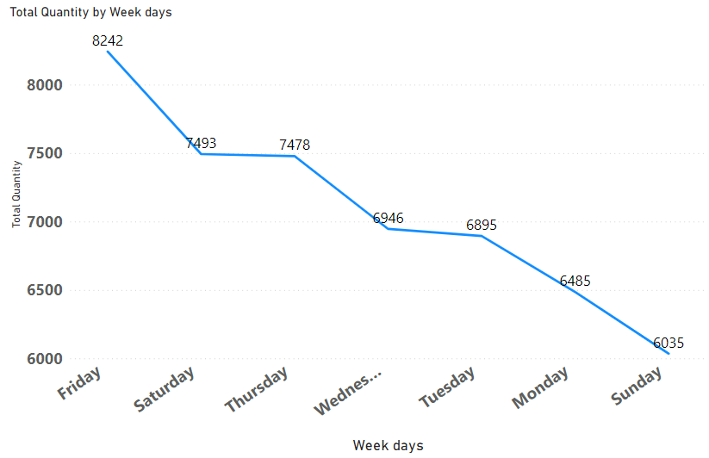
From our Analysis, we found out that on Fridays, more sales were made which may have been as a result of the fact that retailers may want to enjoy the weekend with a delightful Pizza. We also found out that less sales were made on Sundays which may have been as a result of the fact that many people rest from the weeks activities in preparation for a new week.

Slide 8
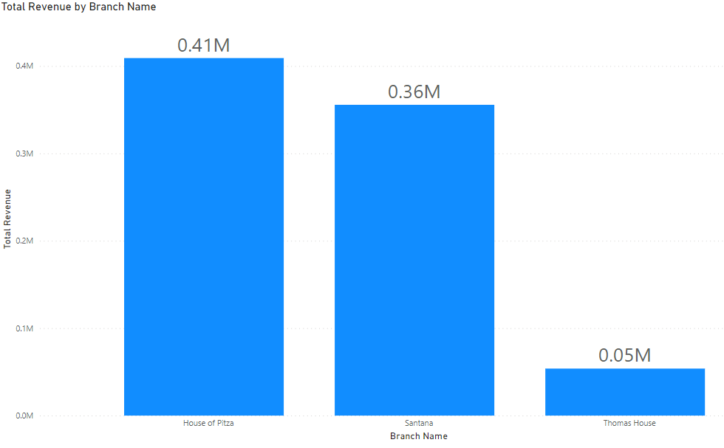
From the Bar Chart, it showed that House of Pitza generated the Highest Revenue of over 0.41Million against the other branches, hence making it a most popular branch in Pizza sales patronage.

Slide 9
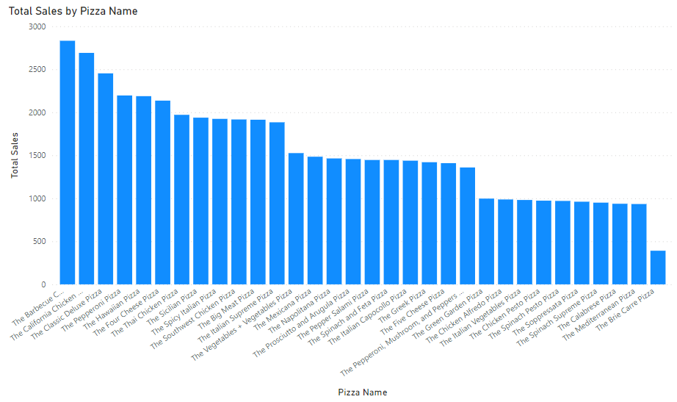
We found out that Scotch Pizza sold more of the Barbecue and California Chicken Pizza while we sold less of the Brie Carrie Pizza during the time periods mentioned earlier which may have been as a result of customer preference

Slide 10
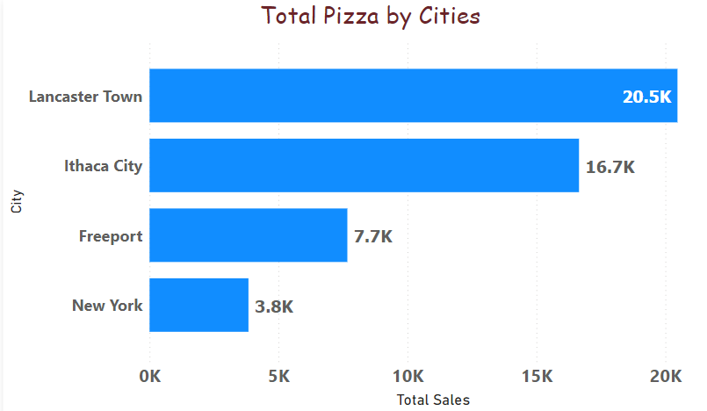
As we can see from the chart the city Lancaster town made the most Pizza sales while New York made the least

Slide 11
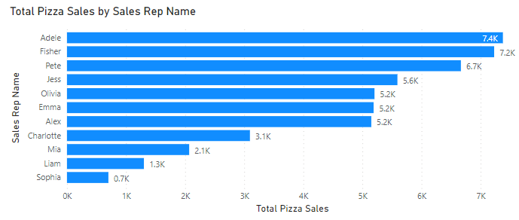
Adele and Fisher sales representatives made the highest sales with a difference of about $6.6K sales revenue from Sophia the least earning sales representative

Slide 12
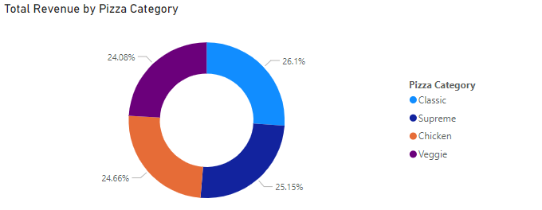
There are 4 pizza categories of which the most earning is the Classic Pizza Category which makes a 26% revenue of the total revenue which isn’t much different from other Pizza Categories as respected Supreme-25.15%, Chicken-24.66%, and Veggie-24.08%

Slide 13

DATA VISUALIZATION

Slide 14
Refer to the PowerBI for our interactive Dashboard
OUR DETAILED ANALYSIS

Slide 15
Limitations Of The Dataset
There was insufficient data to ascertain the profitability performance of the company as a result of the absence of the cost of production of the Pizzas. This is essential to the companies growth.
There is not adequate information concerning the customers. However, we relied on the distinct count of the no. of orders made to presume the no. of customers.

Slide 16
Conclusion / Recommendation
There was a total revenue of $818.58K made from the sales of the 33 Pizza types sold in the 4 cities in which the 3 individual branches are present.
The large size of all the types of Pizzas we sold seemed to be the most bought by the customers compared to other sizes.
The cheapest Pizza type offered by the company is the Peperoni Pizza which sells at a price of about $10 while the highest Sales price is the Greek Pizza which sales at about $36.
The stores open at about 11:00 am and closes at about 10:30 pm.

Slide 17
Conclusion / Recommendation – Cont’d
Barbecue and California Chicken Pizza was most pizza name making it a cash cow. We recommend that the management should sustain the good quality production in other to maintain its market share.
House of Pitza sales performance was the highest and as such we advise that the branch should sustain more pizza production to boost the sales.
The Sales Rep. “Adele” which generated the highest revenue should be encouraged by way of incentives and promotions.
The Sales Rep. “Sophia” that generated the least Revenue, we advise that she should be exposed to more sale/marketing training to enhance her performance.

